Slide 1

Objectives
In this session, you will learn to:
  Describe Input/Output fundamentals
  Construct node and processing streams, and use them appropriately
  Distinguish readers and writers from streams, and select appropriately between them
  Develop code to set up the network connection
  Understand the TCP/IP Protocol
  Use ServerSocket and Socket classes for implementation of TCP/IP clients and servers

Slide 2
I/O Fundamentals
A stream can be thought of as a flow of data from a source or to a sink.
A source stream initiates the flow of data, also called an input stream.
A sink stream terminates the flow of data, also called an output stream.
Sources and sinks are both node streams.
Types of node streams are files, memory, and pipes between threads or processes.

Slide 3
I/O Fundamentals (Contd.)
The fundamental stream classes are:
Stream | Byte Streams | Character Streams
Source streams | InputStream | Reader
Sink streams | OutputStream | Writer

Slide 4
Data Within Streams
Java technology supports two types of streams:
  character
  byte
Input and output of character data is handled by readers and writers.
Input and output of byte data is handled by input streams and output streams.
Normally, the term stream refers to a byte stream.
The terms reader and writer refer to character streams.

Slide 5
The InputStream Methods
The three basic read methods are:
  int read()
  int read(byte[] buffer)
  int read(byte[] buffer, int offset, int
  length)
Other methods include:
  void close()
  int available()
  long skip(long n)
  boolean markSupported()
  void mark(int readlimit)
  void reset()

Slide 6
The OutputStream Methods
The three basic write methods are:
  void write(int c)
  void write(byte[] buffer)
  void write(byte[] buffer, int offset, int
  length)
Other methods include:
  void close()
  void flush()

Slide 7
The Reader Methods
The three basic read methods are:
  int read()
  int read(char[] cbuf)
  int read(char[] cbuf, int offset, int length)
Other methods include:
  void close()
  boolean ready()
  long skip(long n)
  boolean markSupported()
  void mark(int readAheadLimit)
  void reset()

Slide 8
The Writer Methods
The basic write methods are:
  void write(int c)
  void write(char[] cbuf)
  void write(char[] cbuf, int offset, int length)
  void write(String string)
  void write(String string, int offset, int length)
Other methods include:
  void close()
  void flush()

Slide 9
Node Streams
Various types of Character and Byte Stream classes are:
Type | Character Streams | Byte Streams
File | FileReader FileWriter | FileInputStream FileOutputStream
Memory: array | CharArrayReader CharArrayWriter | ByteArrayInputStream ByteArrayOutputStream
Memory: string | StringReader StringWriter | N/A
Pipe | PipedReader PipedWriter | PipedInputStream PipedOutputStream

Slide 10
I/O Stream Chaining
Input Stream Chain:
Data Source
Program
FileInputStream
BufferedInputStream
DataInputStream
Output Stream Chain:
Program
Data Sink
FileOutputStream
BufferedOutputStream
DataOutputStream

Slide 11
Processing Streams
Processing Streams are Node Streams that use filters in
between while transferring the data.
Various types of Processing Streams are:
Type | Character Streams | Byte Streams
Buffering | BufferedReader BufferedWriter | BufferedInputStream BufferedOutputStream
Filtering | FilterReader FilterWriter | FilterInputStream FilterOutputStream
Converting between bytes and character | InputStreamReader OutputStreamWriter
Performing object serialization |  | ObjectInputStream ObjectOutputStream
Performing data Conversion |  | DataInputStream DataOutputStream
Counting | LineNumberReader | LineNumberInputStream

Slide 12
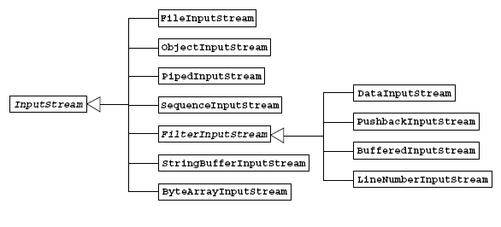
InputStream
The InputStream Class Hierarchy:

Slide 13
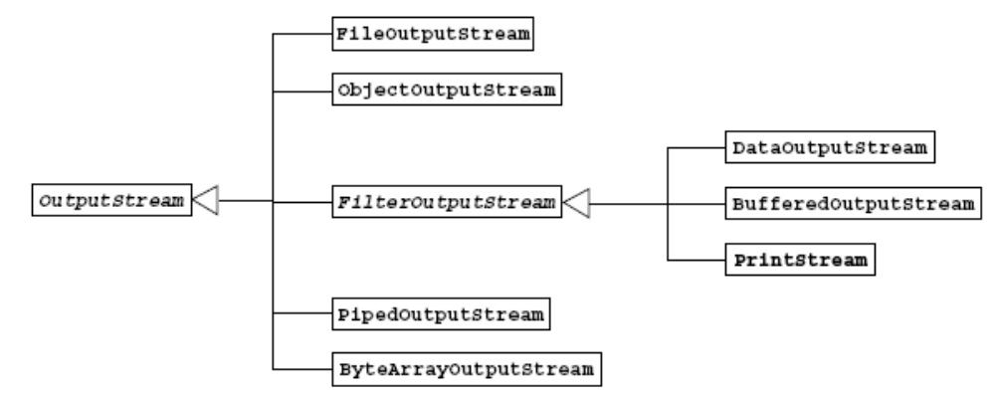
OutputStream
The OutputStream Class Hierarchy:

Slide 14
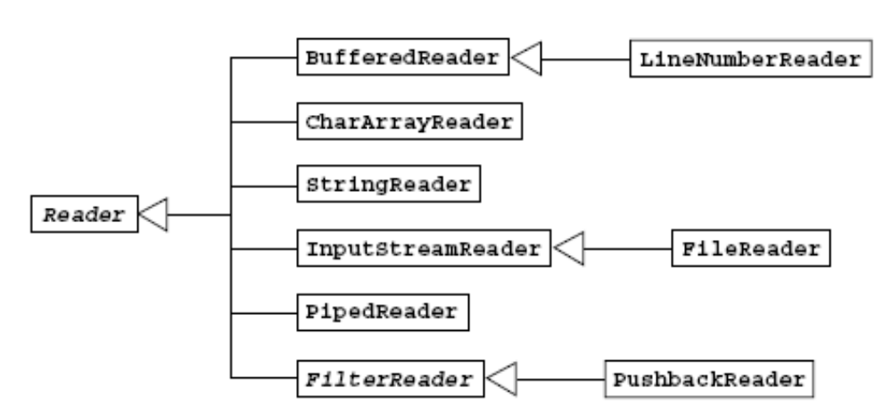
Reader Class
The Reader Class Hierarchy:

Slide 15
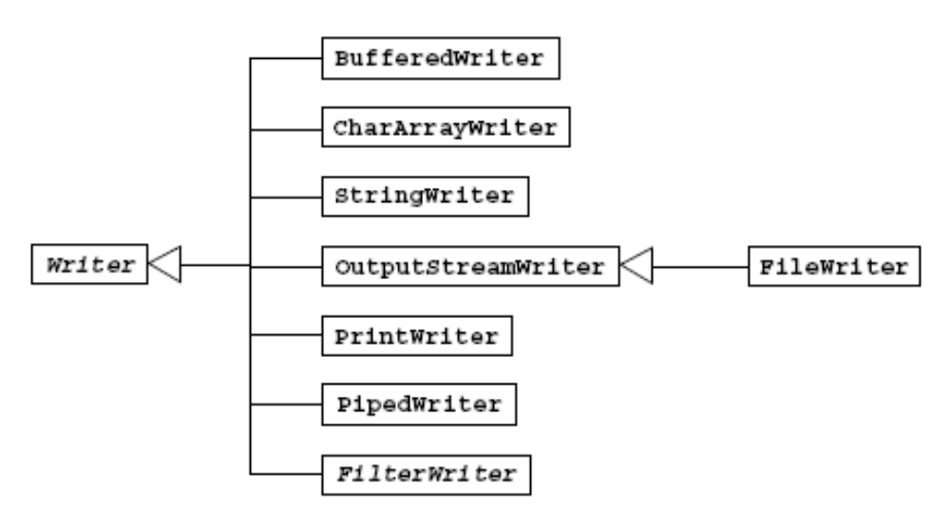
Writer Class
The Writer Class Hierarchy:

Slide 16
Networking
Basics of Networking:
  Computers running on the Internet communicating to each other using the Transmission Control Protocol (TCP) / Internet Protocol (IP).
Client.bar.com
18000
Server. foo.com
3000
Port no.
Client.baz.com
18002

Slide 17
Networking (Contd.)
Networking with Java Technology:
  Sockets:
    Sockets hold two streams, an input stream and an output stream.
    Each end of the socket has a pair of streams.
  Setting Up the Connection:
    Setup of a network connection is similar to a telephone.
    One end must dial the other end, which must be listening.

Slide 18
Networking (Contd.)
  To address the connection, include the following:
    The address or name of remote machine.
    A port number to identify the purpose at the server.
  Port numbers range from 0–65535

Slide 19
Networking (Contd.)
Java Networking Model:
Server
SeverSocket(port#)
ServerSocket.accept()
Register with
this service
Wait for a
connection
Client
Socket(host, port#)
(Attempt to connect)
Socket()
OutputStream
InputStream
OutputStream
InputStream
Socket.close()
Socket.close()

Slide 20
ServerSocket and Socket Classes
Code Snippet for Creating Minimal TCP/IP Server:
  ServerSocket s = null;
  s = new ServerSocket(5432); //Register your service on port 5432
  while (true) // Run the listen/accept loop forever
  {
    Socket s1 = s.accept(); // Wait here and listen for a connection
    OutputStream s1out = s1.getOutputStream();
    // Get output stream associated with the socket
    BufferedWriter bw = new BufferedWriter(new OutputStreamWriter(s1out));
    bw.write(“Hello Net World!\n”); // Send your string!

Slide 21
ServerSocket and Socket Classes (Contd.)
    bw.close(); // Close the connection, but not the server socket
    s1.close();
  }
Code Snippet for Creating Minimal TCP/IP Client:
  // Open your connection to a server, at port 5432
  // localhost used here
  Socket s1 = new Socket("127.0.0.1", 5432);
  // Get an input stream from the socket
  InputStream is = s1.getInputStream();
  //Decorate it with a "data" input stream
  DataInputStream dis = new DataInputStream(is);

Slide 22
ServerSocket and Socket Classes (Contd.)
  // Read the input and print it to the screen
  System.out.println(dis.readUTF());
  // When done, just close the steam and connection
  dis.close();
  s1.close();

Slide 23
Demonstration
Lets see how to create a TCP based Java client, and use user-provided system properties to drive a Java program.

Slide 24
Summary
In this session, you learned that:
  A stream is a flow of data from a source or to a sink.
  A source stream are also called an input stream.
  A sink stream terminates the flow of data, also called an output stream.
  InputStream, OutputStream, Reader, and Writer are fundamental stream classes.
  Three basic read methods of InputStream class are:
    int read()
    int read(byte[] buffer)
    int read(byte[] buffer, int offset, int length)
  Three basic write methods of OutputStream class are:
    void write(int c)
    void write(byte[] buffer)
    void write(byte[] buffer, int offset, int length)

Slide 25
Summary (Contd.)
  Three basic read methods of Reader class are:
    int read()
    int read(char[] cbuf)
    int read(char[] cbuf, int offset, int length)
  The basic write methods of Writer class are:
    void write(int c)
    void write(char[] cbuf)
    void write(char[] cbuf, int offset, int length)
    void write(String string)
    void write(String string, int offset, int length)
  FileReader and FileWriter are file type character streams.
  FileInputStream and FileOutputStream are byte streams classes.
  ServerSocket and Socket are main classes to establish the networking in Java Programs.

Slide 26
Summary (Contd.)
  To setup a network connection the address or name of remote machine and a port number is required.
  accept() method of ServerSocket class is used in server program to receive client sockets to establish connection with the server.
  close() method of Socket class is required to close the connection.

